Slide 1
Storage and File Structure
Overview of Physical Storage Medias
Introduction of some non-volatile storages
Magnetic Disks
Flash
RAID
File organization
Record storage
Organization of Records in Files
Storage buffer management

Slide 2
Physical Storage Medias
Characteristic of Physical Storage
Speed with which data can be accessed
Reliability
data loss on power failure or system crash
physical failure of the storage device
Cost per unit of data ➔ the capacity of single device
Can differentiate storage into:
volatile storage: loses contents when power is switched off
non-volatile storage:
Contents persist even when power is switched off.
Includes secondary and tertiary storage, as well as batter-backed up main-memory.

Slide 3
Some Physical Storage Media
Cache – fastest and most costly form of storage; volatile; managed by the computer system hardware.
Main memory:
fast access (10s to 100s of nanoseconds; 1 nanosecond = 10^{–9} seconds)
generally too small (or too expensive) to store the entire database
capacities of up to a tens of Gigabytes widely used currently
Capacities have gone up and per-byte costs have decreased steadily and rapidly (roughly factor of 2 every 2 to 3 years)
Volatile — contents of main memory are usually lost if a power failure or system crash occurs.

Slide 4
Some Physical Storage Media (Cont.)
Flash memory
Data survives power failure
Data can be written at a location only once, but location can be erased and written to again
Can support limited number of write/erase cycles.
Erasing of memory has to be done to an entire bank of memory
Reads are roughly as fast as main memory
But writes are slow (few microseconds), erase is slower
Cost per unit of storage is lower than main memory, but higher than magnetic-disk
Is replacing the magnetic-disk as the secondary storage.

Slide 5
Some Physical Storage Media (Cont.)
Magnetic-disk
Data is stored on spinning disk, and read/written magnetically
Primary medium for the long-term storage of data; typically stores entire database.
Data must be moved from disk to main memory for access, and written back for storage
Much slower access than main memory (more on this later)
direct-access – possible to read data on disk in any order, unlike magnetic tape
Capacities range up to roughly 10~100TB currently
Much larger capacity and cost/byte than main memory/flash memory
Growing constantly and rapidly with technology improvements (factor of 2 to 3 every 2 years)
Survives power failures and system crashes
disk failure can destroy data, but is very rare

Slide 6
Some Physical Storage Media (Cont.)
Optical storage
non-volatile, data is read optically from a spinning disk using a laser
CD-ROM (640 MB) and DVD (4.7 to 17 GB) most popular forms
Blu-ray DVD has capacity of 27G to 128G
Write-one, read-many (WORM) optical disks used for archival storage (CD-R and DVD-R)
Multiple write versions also available (CD-RW, DVD-RW, and DVD-RAM)
Reads and writes are slower than with magnetic disk
Juke-box systems, with large numbers of removable disks, a few drives, and a mechanism for automatic loading/unloading of disks available for storing large volumes of data

Slide 7
Some Physical Storage Media (Cont.)
Tape storage
non-volatile, used primarily for backup (to recover from disk failure), and for archival data
sequential-access – much slower than disk
very high capacity (40 to 300 TB tapes available)
tape can be removed from drive ⇒ storage costs much cheaper than disk, but drives are expensive
Tape jukeboxes available for storing massive amounts of data
hundreds of terabytes (1 terabyte = 10⁹ bytes) to even a petabyte (1 petabyte = 10¹² bytes) -----this was 10 years ago
hundreds of perabytes (1 perabyte = 1024 terabtyes) to even a Exabyte (1 exabyte = 1024 perabytes) ----this is going to be very soon.

Slide 8
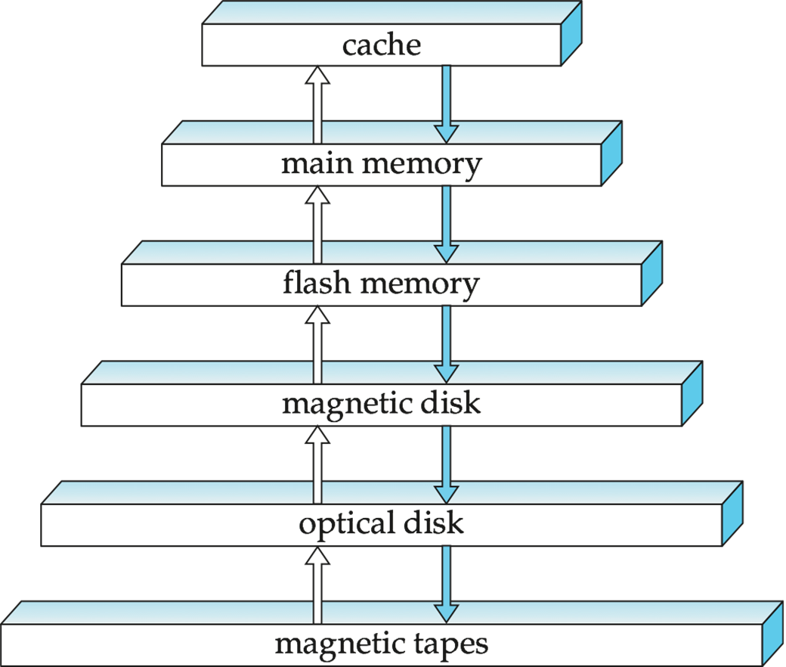
Storage Hierarchy

Slide 9
Storage Hierarchy
primary storage: Fastest media but volatile (cache, main memory).
secondary storage: next level in hierarchy, non-volatile, moderately fast access time
also called on-line storage
E.g. flash memory, magnetic disks
tertiary storage: lowest level in hierarchy, non-volatile, slow access time, but Large volume
and cheap
also called off-line storage
E.g. magnetic tape, optical storage

Slide 10
Storage Interfaces
Disk interface standards families, usually connected directly to computer system
SATA (Serial ATA)
SATA 3 supports data transfer speeds of up to 6 gigabits/sec
SAS (Serial Attached SCSI)
SAS Version 3 supports 12 gigabits/sec
NVMe (Non-Volatile Memory Express) interface
Works with PCIe connectors to support lower latency and higher transfer rates, to better support SSDs
Supports data transfer rates of up to 24 gigabits/sec
In Storage Area Networks (SAN), a large number of disks are connected by a high-speed network to a number of servers
In Network Attached Storage (NAS) networked storage provides a file system interface using networked file system protocol, instead of providing a disk system interface
In Cloud Storage, data are stored in the cloud and accessed via an API. Has a very high latency if the data are not co-located with the database. Need new technique for the cloud-base storage systems.

Slide 11
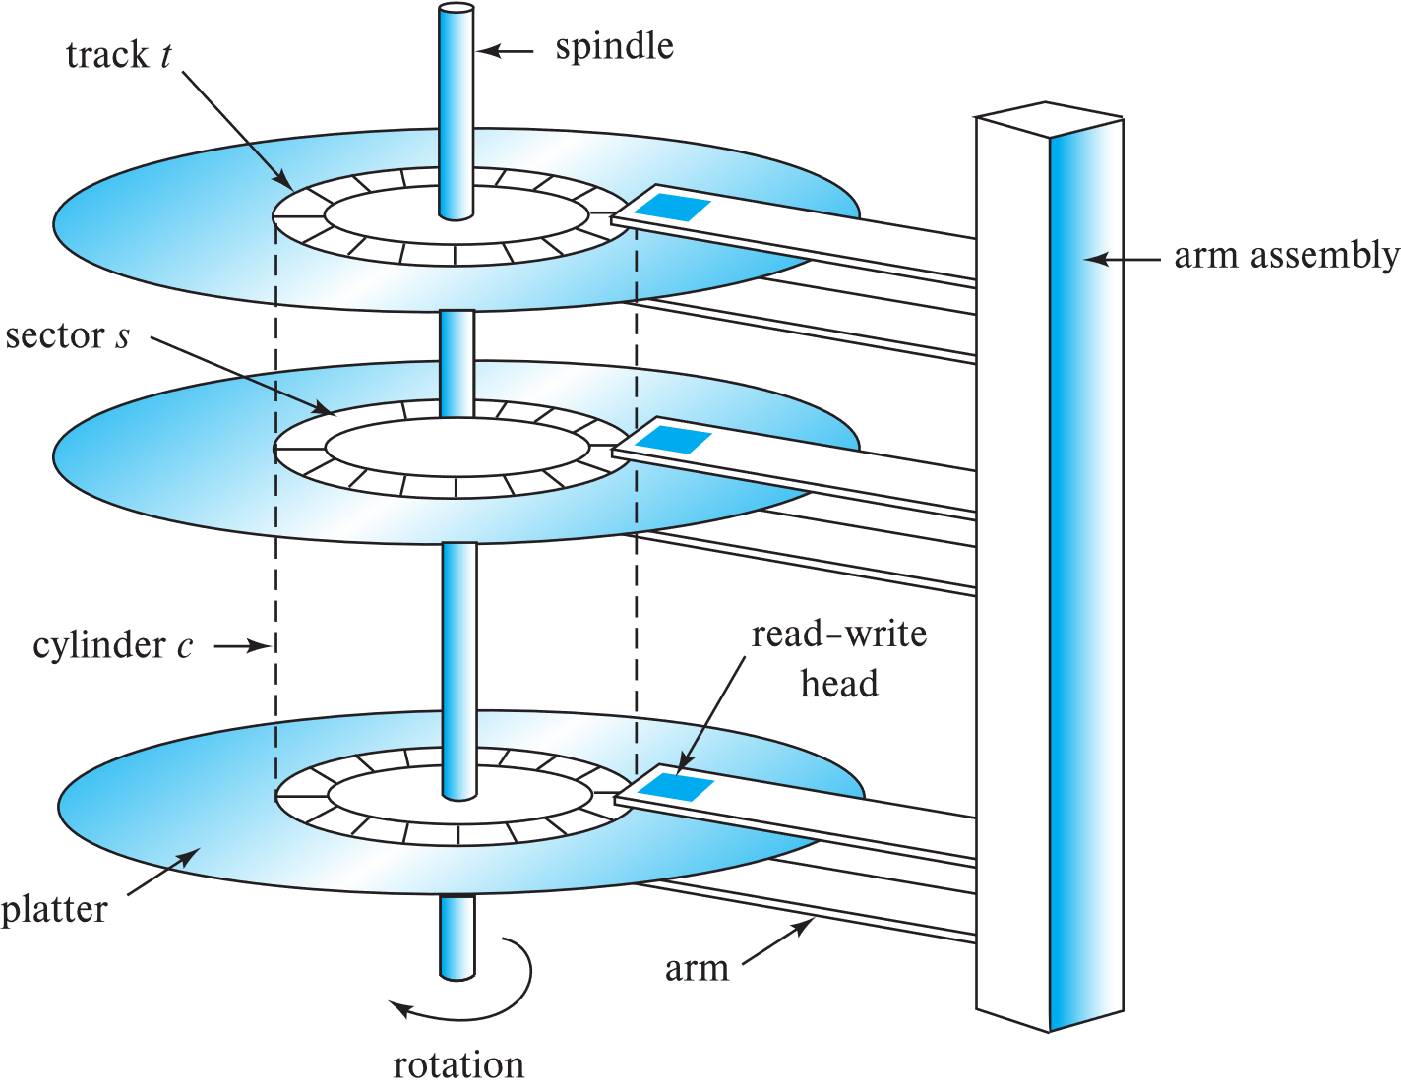
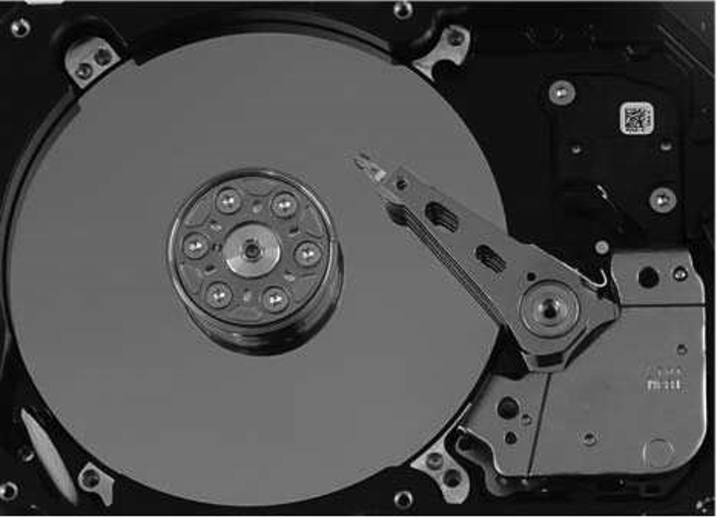
Magnetic Hard Disk Mechanism
Schematic diagram of magnetic disk drive
Photo of magnetic disk drive

Slide 12
Magnetic Disks
Read-write head
Positioned very close to the platter surface (almost touching it)
Reads or writes magnetically encoded information.
Surface of platter divided into circular tracks
Over 50K~100K tracks per platter on typical hard disks
Each track is divided into sectors.
A sector is the smallest unit of data that can be read or written.
Sector size typically 512 bytes
Typical sectors per track: 500 (on inner tracks) to 1000 (on outer tracks)
To read/write a sector
disk arm swings to position head on right track
platter spins continually; data is read/written as sector passes under head
Head-disk assemblies
multiple disk platters on a single spindle (typically 1 to 5)
one head per platter, mounted on a common arm.
Cylinder i consists of i^{th} track of all the platters

Slide 13
Magnetic Disks (Cont.)
Disk controller – interfaces between the computer system and the disk drive hardware.
accepts high-level commands to read or write a sector
initiates actions such as moving the disk arm to the right track and actually reading or writing the data
Computes and attaches checksums to each sector to verify that data is read back correctly
If data is corrupted, with very high probability stored checksum won’t match recomputed checksum
Ensures successful writing by reading back sector after writing it
Performs remapping of bad sectors

Slide 14
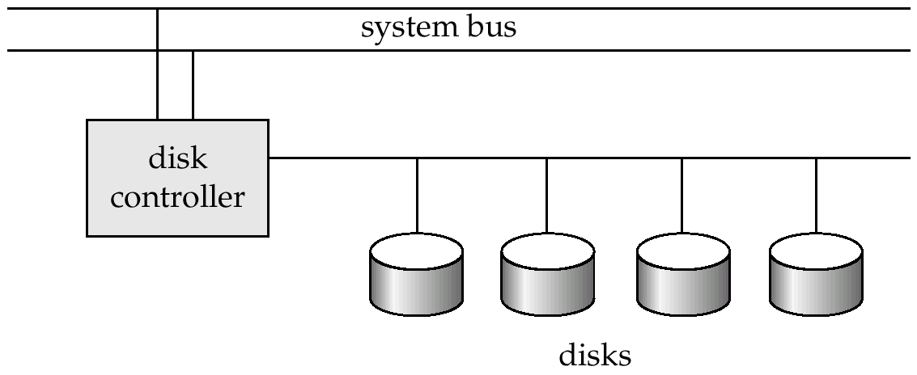
Disk Subsystem
Multiple disks connected to a computer system through a controller
Controllers functionality (checksum, bad sector remapping) often carried out by individual disks; reduces load on controller

Slide 15
Performance Measures of Disks
Access time – the time it takes from when a read or write request is issued to when data transfer begins. Consists of:
Seek time – time it takes to reposition the arm over the correct track.
Average seek time is 1/2 the worst case seek time.
Would be 1/3 if all tracks had the same number of sectors, and we ignore the time to start and stop arm movement
4 to 10 milliseconds on typical disks
Rotational latency – time it takes for the sector to be accessed to appear under the head.
Average latency is 1/2 of the worst case latency.
4 to 11 milliseconds on typical disks (5400 to 15000 r.p.m.)
Overall latency is 5 to 20 milliseconds depending on disk model
Data-transfer rate – the rate at which data can be retrieved from or stored to the disk.
25 to 100 MB per second is typical
Multiple disks may share a controller, so rate that controller can handle is also important
E.g. SATA: 150 MB/sec, SATA-II 3Gb (300 MB/sec)
Ultra 320 SCSI: 320 MB/s, SAS (3 to 6 Gb/sec)
Fiber Channel (FC2Gb or 4Gb): 256 to 512 MB/s

Slide 16
Performance Measures (Cont.)
Disk block is a logical unit for storage allocation and retrieval
4 to 16 kilobytes typically
Smaller blocks: more transfers from disk
Larger blocks: more space wasted due to partially filled blocks
Sequential access pattern
Successive requests are for successive disk blocks
Disk seek required only for first block
Random access pattern
Successive requests are for blocks that can be anywhere on disk
Each access requires a seek
Transfer rates are low since a lot of time is wasted in seeks
I/O operations per second (IOPS)
Number of random block reads that a disk can support per second
50 to 200 IOPS on current generation magnetic disks

Slide 17
Performance Measures (Cont.)
Mean time to failure (MTTF) – the average time the disk is expected to run continuously without any failure.
Typically 3 to 5 years
Probability of failure of a single new disks is quite low, corresponding to a “theoretical MTTF” of 30,000 to 1,200,000 hours for a new disk.
MTTF is mainly been used to measure the probability of multiple disk’s failure.
E.g., an MTTF of 1,200,000 hours for a new disk means that given 1000 relatively new disks, on an average one will fail every 1200 hours
MTTF decreases as disk ages

Slide 18
Flash Storage
NOR flash vs NAND flash
NAND flash
used widely for storage, cheaper than NOR flash
requires page-at-a-time read (page: 512 bytes to 4 KB)
20 to 100 microseconds for a page read
Not much difference between sequential and random read
Page can only be written once
100 microseconds for a page write
Must be erased to allow rewrite
Solid state disks
Use standard block-oriented disk interfaces, but store data on multiple flash storage devices internally
Transfer rate of up to 500 MB/sec using SATA, and up to 3 GB/sec using NVMe PCIe

Slide 19
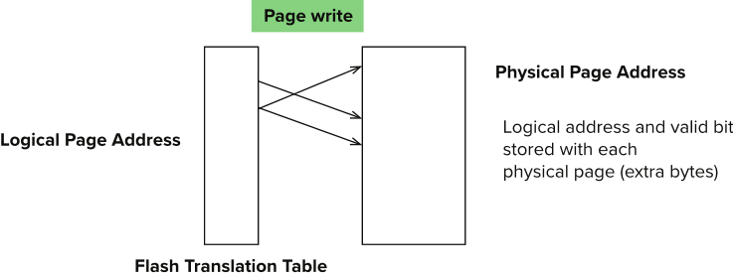
Flash Storage (Cont.)
Erase happens in units of erase block
Takes 2 to 5 milliseconds, very slow….
Erase block typically 256 KB to 1 MB (128 to 256 pages)
Remapping of logical page addresses to physical page addresses avoids waiting for erase
Flash translation table tracks mapping
also stored in a label field of flash page
remapping carried out by flash translation layer
After 100,000 to 1,000,000 erases, erase block becomes unreliable and cannot be used
wear leveling to manage the block erasing equally distributed across the flash storage device
Notes:
Where is FTL stored? How is it reconstructed on system startup?
How to track number of erases per block (extra storage per block)

Slide 20
SSD Performance Metrics
Random reads/writes per second
Typical 4 KB reads: 10,000 reads per second (10,000 IOPS)
Typical 4KB writes: 40,000 IOPS
SSDs support parallel reads
Typical 4KB reads:
100,000 IOPS with 32 requests in parallel (QD-32) on SATA
350,000 IOPS with QD-32 on NVMe PCIe
Typical 4KB writes:
100,000 IOPS with QD-32, even higher on some models
Data transfer rate for sequential reads/writes
400 MB/sec for SATA3, 2 to 3 GB/sec using NVMe PCIe
Hybrid disks: combine small amount of flash cache with larger magnetic disk

Slide 21
RAID
RAID: Redundant Arrays of Independent Disks
disk organization techniques that manage a large numbers of disks, providing a view of a single disk of
high capacity and high speed by using multiple disks in parallel, and
high reliability by storing data redundantly, so that data can be recovered even if a disk fails
The chance that some disk out of a set of N disks will fail is much higher than the chance that a specific single disk will fail.
E.g., a system with 100 disks, each with MTTF of 100,000 hours (approx. 11 years), will have a system MTTF of 1000 hours (approx. 41 days)
Techniques for using redundancy to avoid data loss are critical with large numbers of disks
Originally a cost-effective alternative to large, expensive disks
I in RAID originally stood for ``inexpensive’’
Today RAIDs are used for their higher reliability and bandwidth.
The “I” is interpreted as independent

Slide 22
Improvement of Reliability via Redundancy
Redundancy – store extra information that can be used to rebuild information lost in a disk failure
E.g., Mirroring (or shadowing)
Duplicate every disk. Logical disk consists of two physical disks.
Every write is carried out on both disks
Reads can take place from either disk
If one disk in a pair fails, data still available in the other
Data loss would occur only if a disk fails, and its mirror disk also fails before the system is repaired
Probability of combined event is very small
Except for dependent failure modes such as fire or building collapse or electrical power surges
Mean time to data loss depends on mean time to failure, and mean time to repair
E.g., MTTF of 100,000 hours, mean time to repair of 10 hours gives mean time to data loss of 500*10⁶ hours (or 57,000 years) for a mirrored pair of disks (ignoring dependent failure modes)

Slide 23
Improvement in Performance via Parallelism
Two main goals of parallelism in a disk system:
1. Load balance multiple small accesses to increase throughput
2. Parallelize large accesses to reduce response time.
Improve transfer rate by striping data across multiple disks.
Bit-level striping – split the bits of each byte across multiple disks
In an array of eight disks, write bit i of each byte to disk i.
Each access can read data at eight times the rate of a single disk.
But seek/access time worse than for a single disk
Bit level striping is not used much any more
Block-level striping – with n disks, block i of a file goes to disk (i mod n) + 1
Requests for different blocks can run in parallel if the blocks reside on different disks
A request for a long sequence of blocks can utilize all disks in parallel

Slide 24
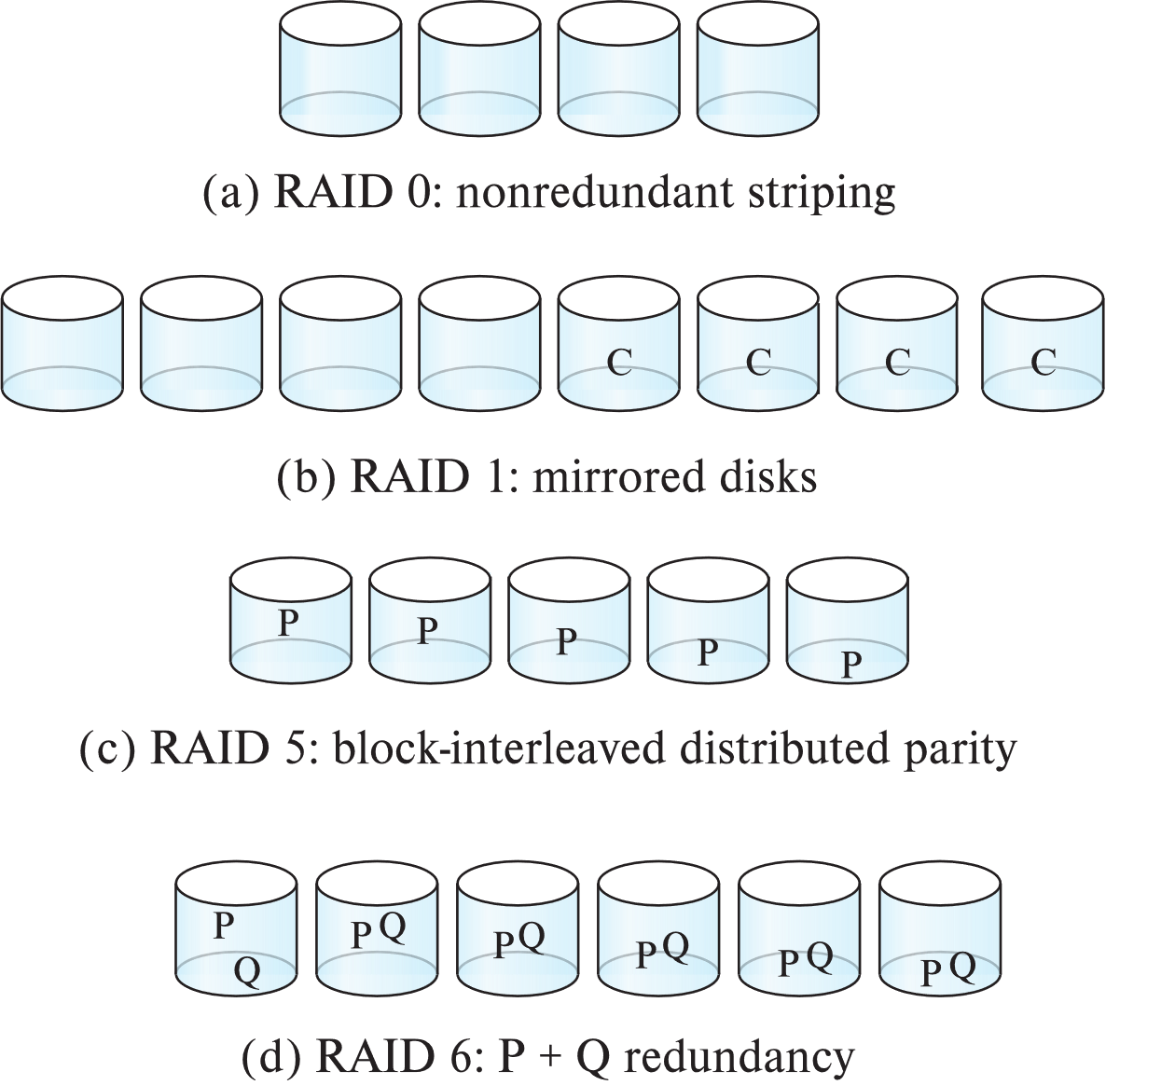
RAID Levels
Schemes to provide redundancy at lower cost by using disk striping combined with parity bits
Different RAID organizations, or RAID levels, have differing cost, performance and reliability characteristics
RAID Level 0: Block striping; non-redundant.
Used in high-performance applications where data loss is not critical.
RAID Level 1: Mirrored disks with block striping
Offers best write performance.
Popular for applications such as storing log files in a database system.

Slide 25
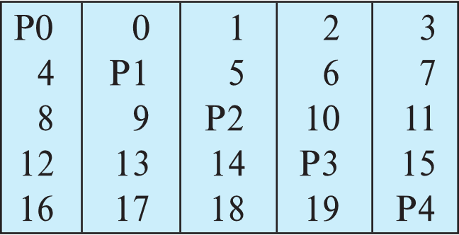
RAID Level 5
RAID Level 5: Block-Interleaved Distributed Parity; partitions data and parity among all N + 1 disks, rather than storing data in N disks and parity in 1 disk.
E.g., with 5 disks, parity block for nth set of blocks is stored on disk (n mod 5) + 1, with the data blocks stored on the other 4 disks.

Slide 26
Choice of RAID Level
RAID 0 is used in a few high-performance applications where data safety is not critical.
E.g., data can be recovered quickly from other sources
Level 1 provides much better write performance than level 5
Level 5 requires at least 2 block reads and 2 block writes to write a single block, whereas Level 1 only requires 2 block writes
Level 1 preferred for high update environments such as log disks
Level 1 had higher storage cost than level 5
Level 5 is preferred for applications with low update rate, and new large amounts of data
Level 1 is preferred for applications with many random/small updates.

Slide 27
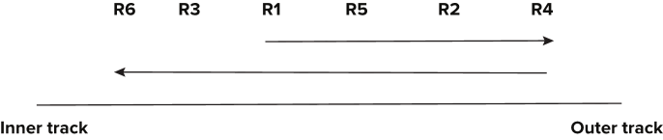
Optimization of Disk-Block Access
Block – a contiguous sequence of sectors from a single track
data is transferred between disk and main memory in blocks
sizes range from 512 bytes to several kilobytes
Smaller blocks: more transfers from disk
Larger blocks: more space wasted due to partially filled blocks
Typical block sizes today range from 4 to 16 kilobytes
Buffering: in-memory buffer to cache disk blocks
Read-ahead: When a disk block is accessed, consecutive blocks from the same track are read into an in-memory buffer.
Disk-arm-scheduling: algorithms order pending accesses to tracks so that disk arm movement is minimized
elevator algorithm : move disk arm in one direction (from outer to inner tracks or vice versa), processing next request in that direction, till no more requests in that direction, then reverse direction and repeat

Slide 28
Optimization of Disk Block Access (Cont.)
File organization – optimize block access time by organizing the blocks to correspond to how data will be accessed
E.g. Store related information on the same or nearby cylinders.
Files may get fragmented over time
E.g. if data is inserted to/deleted from the file
Or free blocks on disk are scattered, and newly created file has its blocks scattered over the disk
Sequential access to a fragmented file results in increased disk arm movement
Some systems have utilities to defragment the file system, in order to speed up file access

Slide 29
Optimization of Disk Block Access (Cont.)
Nonvolatile write buffers speed up disk writes by writing blocks to a non-volatile RAM buffer immediately
Non-volatile RAM: battery backed up RAM or flash memory
Even if power fails, the data is safe and will be written to disk when power returns
Controller then writes to disk whenever the disk has no other requests or request has been pending for some time
Database operations that require data to be safely stored before continuing can continue without waiting for data to be written to disk
Writes can be reordered to minimize disk arm movement
Log disk – a disk devoted to writing a sequential log of block updates
Used exactly like nonvolatile RAM
Write to log disk is very fast since no seeks are required
No need for special hardware (NV-RAM)
File systems typically reorder writes to disk to improve performance
Journaling file systems write data in safe order to NV-RAM or log disk
Reordering without journaling: risk of corruption of file system data

Slide 30
File Organization
The database is stored as a collection of files. Each file is a sequence of records. A record is a sequence of fields.
The fundamental consideration of database file organization:
Each file is logically partitioned into fixed-length storage units called blocks, which are the units of both storage allocation and data transfer.
A block may contain several records, there are two assumptions in traditional database system:
No record is larger then a block;
Each record is entirely contained in a single record.
Start with one simple approach:
assume record size is fixed
each file has records of one particular type only
different files are used for different relations
This case is easiest to implement; will consider variable length records later.

Slide 31
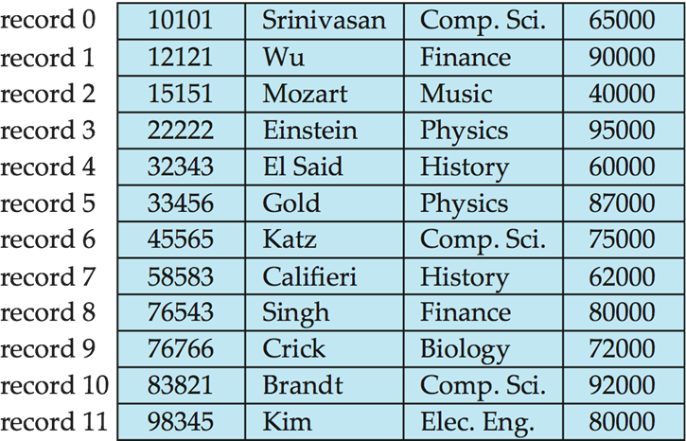
Fixed-Length Records
Simple approach:
Store record i starting from byte n ∗ (i – 1), where n is the size of each record.
Record access is simple but records may cross blocks
Modification: do not allow records to cross block boundaries
Deletion of record I: alternatives:
move records i + 1, . . ., n to i, . . . , n – 1
move record n to i
do not move records, but link all free records on a free list

Slide 32
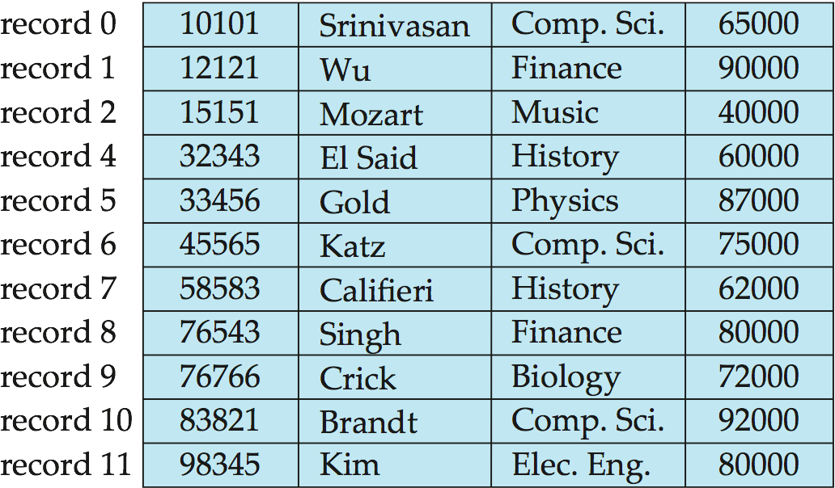
Deleting record 3 and compacting

Slide 33
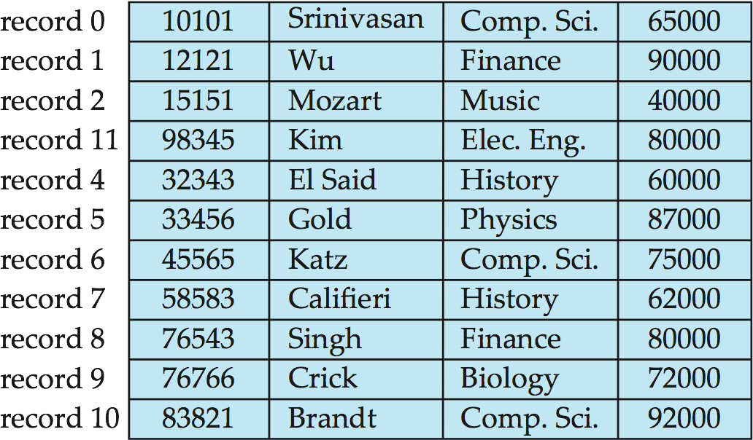
Deleting record 3 and moving last record

Slide 34
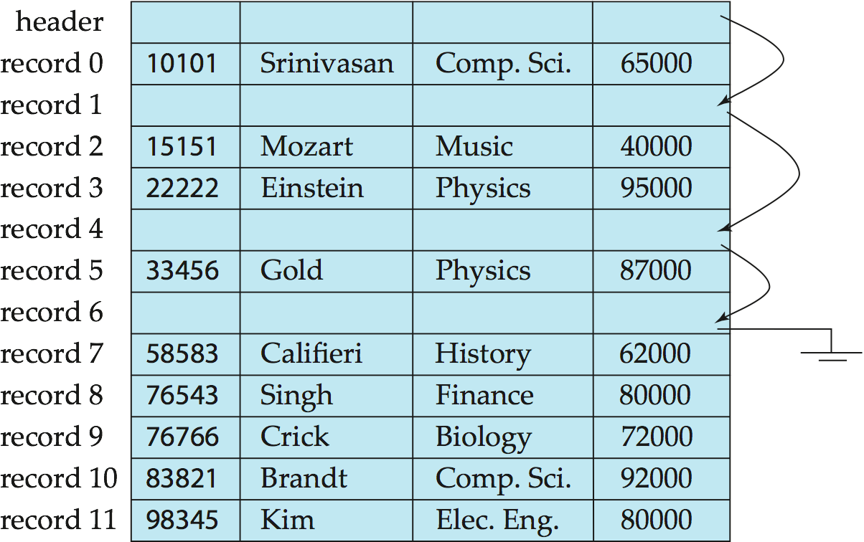
Free Lists
Store the address of the first deleted record in the file header.
Use this first record to store the address of the second deleted record, and so on
Can think of these stored addresses as pointers since they “point” to the location of a record.
More space efficient representation: reuse space for normal attributes of free records to store pointers. (No pointers stored in in-use records.)

Slide 35
Variable-Length Records
Variable-length records arise in database systems in several ways:
Storage of multiple record types in a file.
Record types that allow variable lengths (such as varchar) for one or more fields.
Record types that allow repeating fields, such as array.
How to store a variable-length record
Typical variable-length record
How to store variable-length records in a block
Slotted Page Structure

Slide 36
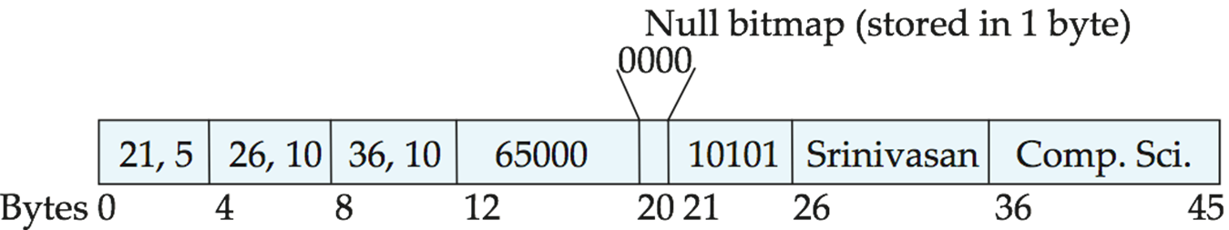
Structure of Variable-Length Record
Typical Variable-length record:
Attributes are stored in order
Variable length attributes represented by fixed size (offset, length), with actual data stored after all fixed length attributes
Null values represented by null-value bitmap
A sample record of instructor

Slide 37
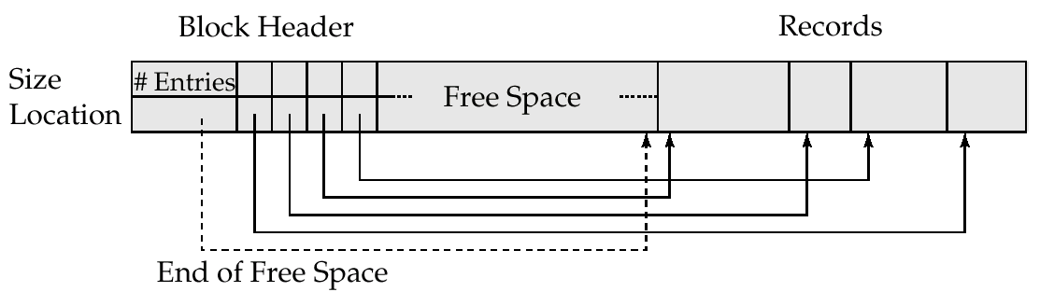
Slotted Page Structure
Slotted page header contains:
number of record entries
end of free space in the block
location and size of each record
Records can be moved around within a page to keep them contiguous with no empty space between them; entry in the header must be updated.
Pointers should not point directly to record — instead they should point to the entry for the record in header. <page#, record#>

Slide 38
Restriction of record size
Most of relational database restrict the size of a record to be no larger than the size of block.
No record is larger then a block;
Each record is entirely contained in a single record.
The record and block structure is the reason of the restriction.
More important, the disk access method and written atomic is the fundamental reason of the structure.
Blob and Clob：Database store data that can be much larger than a disk block.

Slide 39
Organization of Records in Files
Heap – record can be placed anywhere in the file where there is space
Sequential – store records in sequential order, based on the value of the search key of each record
In a multi-table clustering file organization records of several different relations can be stored in the same file
Motivation: store related records on the same block to minimize I/O
B⁺-tree file organization
Ordered storage even with inserts/deletes
Hashing – a hash function computed on search key; the result specifies in which block of the file the record should be placed

Slide 40
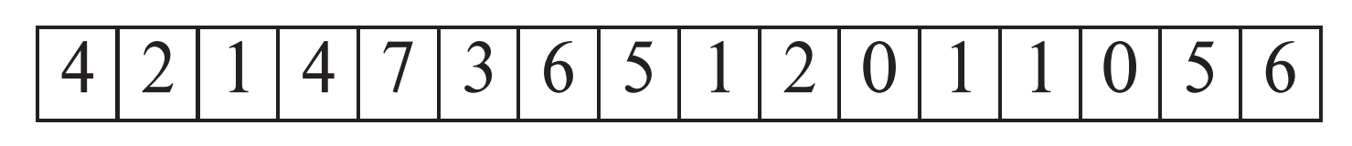
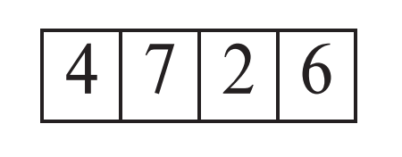
Heap File Organization
Records can be placed anywhere in the file where there is free space
Records usually do not move once allocated
Important to be able to efficiently find free space within file
Free-space map
Array with 1 entry per block. Each entry is a few bits to a byte, and records fraction of block that is free. A byte (256 values) would be enough.
In example below, 3 bits per block, value divided by 8 indicates fraction of block that is free
Can have second-level free-space map
In example below, each entry stores maximum from 4 entries of first-level free-space map
Free space map written to disk periodically, OK to have wrong (old) values for some entries (will be detected and fixed)

Slide 41
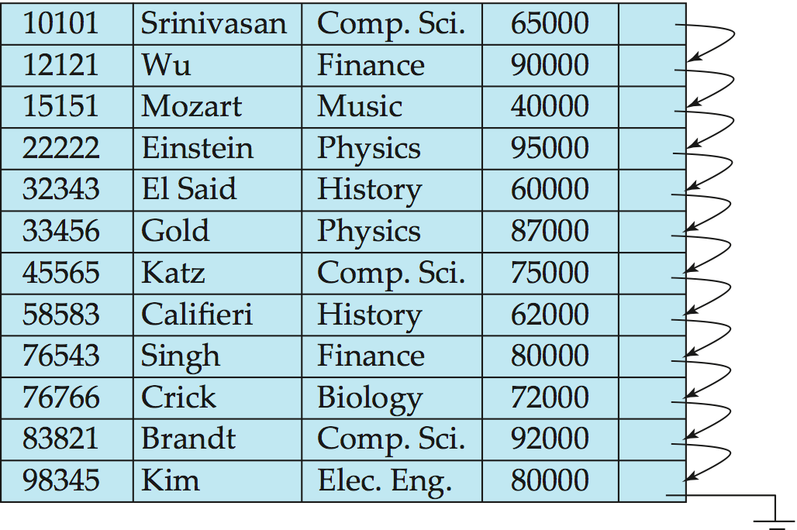
Sequential File Organization
Suitable for applications that require sequential processing of the entire file
The records in the file are ordered by a search-key

Slide 42
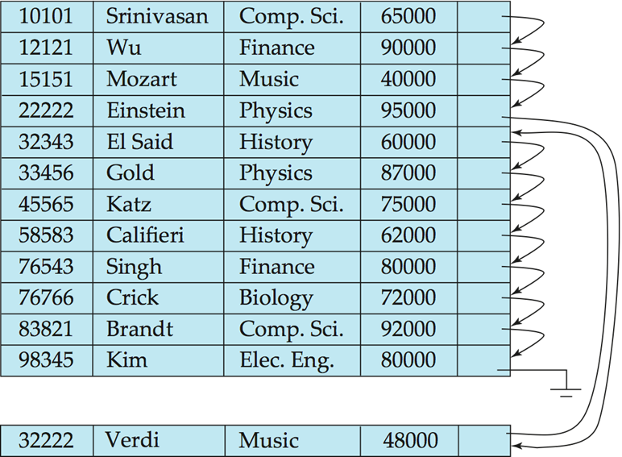
Sequential File Organization (Cont.)
Deletion – use pointer chains
Insertion –locate the position where the record is to be inserted
if there is free space insert there
if no free space, insert the record in an overflow block
May cause block split
In either case, pointer chain must be updated
Need to reorganize the file from time to time to restore sequential order

Slide 43
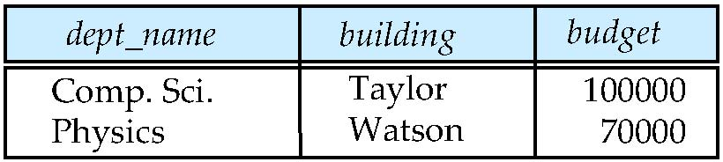
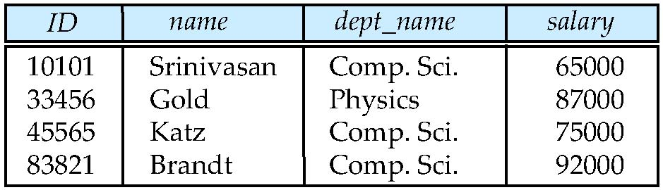
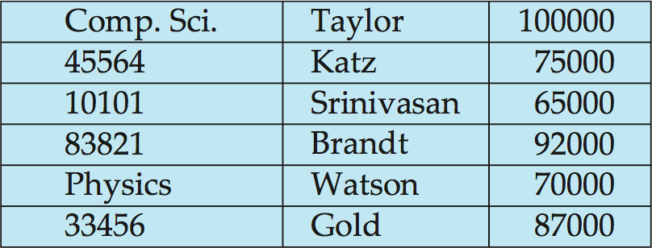
Multi-table Clustering File Organization
Store several relations in one file using a multitable clustering file organization
department
instructor
multitable clustering
of department and
instructor

Slide 44
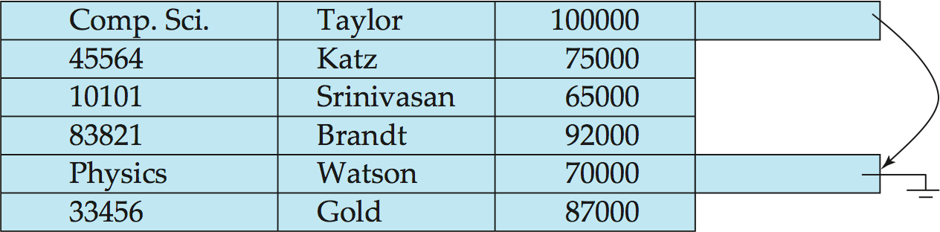
Multitable Clustering File Organization (cont.)
results in variable size records
good for queries involving department instructor, and for queries involving one single department and its instructors
bad for queries involving only department
Can add pointer chains to link records of a particular relation

Slide 45
Partitioning
Table partitioning: Records in a relation can be partitioned into smaller relations that are stored separately
E.g., transaction relation may be partitioned into transaction_2018, transaction_2019, etc.
Queries written on transaction must access records in all partitions
Unless query has a selection such as year=2019, in which case only one partition in needed
Partitioning
Reduces costs of some operations such as free space management
Allows different partitions to be stored on different storage devices
E.g., transaction partition for current year on SSD, for older years on magnetic disk

Slide 46
Data Dictionary
The Data dictionary (also called system catalog) stores metadata; that is, data about data, such as
Information about relations
names of relations
names, types and lengths of attributes of each relation
names and definitions of views
integrity constraints
Statistical and descriptive data
number of tuples in each relation
number of the blocks in each relation
distinct values of some attributes
Physical file organization information
How relation is stored (sequential/hash/…)
Physical location of relation
Information about indices ( next lecture )
User and accounting information, including passwords

Slide 47
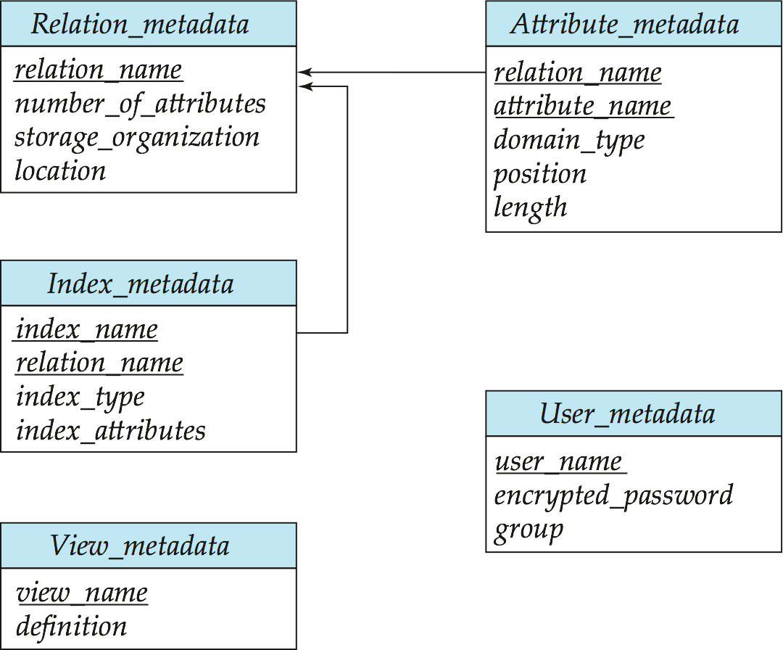
Data Dictionary Storage
Relational representation on disk with pre-defined schema
Specialized data structures designed for efficient access, in memory

Slide 48
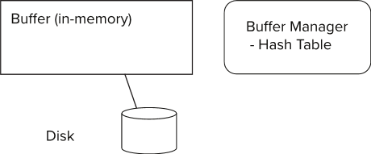
Storage Buffer Management
A database file is partitioned into fixed-length storage units (blocks).
Blocks are units of both storage allocation and data transfer.
Database system seeks to minimize the number of block transfers between the disk and memory to improve the overall system performance
We can reduce the number of disk accesses by keeping as many blocks as possible in main memory.
Buffer – portion of main memory available to store copies of disk blocks.
Buffer manager – subsystem responsible for allocating buffer space in main memory.

Slide 49
Buffer Manager
Other modules call on the buffer manager when they need a block from disk.
If the block is already in the buffer, the requesting program is given the address of the block in main memory
If the block is not in the buffer,
The buffer manager allocates space in the buffer for the block. if required, replacing (throwing out) some other block to make space for the new block.
The block that is thrown out is written back to disk only if it was modified since the most recent time that it was written to/fetched from the disk.
Once space is allocated in the buffer, the buffer manager reads the block from the disk to the buffer, and passes the address of the block in main memory to requester.

Slide 50
Buffer-Replacement Policies
Most operating systems replace the block least recently used (LRU strategy)
Idea behind LRU – use past pattern of block references as a predictor of future references
DBMS can have more sophisticate strategy, because Queries have well-defined access patterns (such as sequential scans), and DBMS can use the information to predict future references
LRU can be a bad strategy for certain access patterns involving repeated scans of data
e.g. when computing the join of 2 relations r and s by a nested loops for each tuple tr of r do for each tuple ts of s do if the tuples tr and ts match …
In this case, Most recently used (MRU) strategy should be used
Mixed strategy with hints on replacement strategy provided by the query optimizer is preferable

Slide 51
Buffer-Replacement Policies (Cont.)
Pinned block – memory block that is not allowed to be written back to disk.
Block in processing
Block is not the right time to be written out (Recovery)
Buffer managers need support forced output of blocks for the purpose of recovery (more later)
Toss-immediate strategy – frees the space occupied by a block as soon as the final tuple of that block has been processed
Buffer manager can use statistical information regarding the probability that a request will reference a particular relation
E.g., the data dictionary is frequently accessed. Heuristic: keep data-dictionary blocks in main memory buffer

Slide 52
Optimization of Disk Block Writes
Nonvolatile write buffers speed up disk writes by writing blocks to a non-volatile RAM or flash buffer immediately
Writes can be reordered to minimize disk arm movement
Log disk – a disk devoted to writing a sequential log of block updates
Used exactly like nonvolatile RAM
Write to log disk is very fast since no seeks are required
Journaling file systems write data in-order to NV-RAM or log disk
Reordering without journaling: risk of corruption of file system data
Operating system or buffer manager may reorder writes
Can lead to corruption of data structures on disk
E.g., linked list of blocks with missing block on disk
File systems perform consistency check to detect such situations
Careful ordering of writes can avoid many such problems

Slide 53
Project- MiniSQL
任务目标
设计并实现一个精简型单用户SQL引擎MiniSQL，允许用户通过字符界面输入SQL语句实现基本的增删改查操作，并能够通过索引来优化性能。
通过对MiniSQL的设计与实现，提高学生的系统编程能力，加深对数据库管理系统底层技术的理解。
系统需求
数据类型：要求支持三种基本数据类型：integer，char(n)，float。
表定义：一个表可以定义多达32个属性，各属性可以指定是否为unique，支持单属性的主键定义。
索引定义：对于表的主属性自动建立B+树索引，对于声明为unique的属性也需要建立B+树索引。
数据操作: 可以通过and或or连接的多个条件进行查询，支持等值查询和区间查询。支持每次一条记录的插入操作；支持每次一条或多条记录的删除操作。
在工程实现上，使用源代码管理工具（如Git）进行代码管理，代码提交历史和每次提交的信息清晰明确；同时编写的代码应符合代码规范，具有良好的代码风格。
参考链接：https://www.yuque.com/yingchengjun/pcp6qx

